Slide 1
Datathon 2021
Team Member(s): Minh Hai Nguyen

Slide 2
Introduction
Hi, I’m Hai! (Minh Hai Nguyen)
Nationalities: Czech & Vietnamese
University: Queen Mary, University of London
Major: MSc. Machine Learning for Visual Data Analytics
Background: BSc. Computer Science
LinkedIn: https://www.linkedin.com/in/nminhhai/

Slide 3
Topic: The New Normal under COVID
NLP, sentiment analysis, twitter web scraping, data visualisation with streamlit

Slide 4
Why is this important?
COVID is a recent event which had a global impact
Twitter is a massive social media platform and using NLP, one can gain valuable insight
NLP is powerful in social sciences where one can analyse human’s attributes such as behavior, emotion or preference, hence the application is wide (understanding customers, replicating humans’ responses through chatbots etc.)

Slide 5
Method

Slide 6
NLP: Sentiment Classifier - Pre-processing
Amazon app review dataset obtained from: http://jmcauley.ucsd.edu/data/amazon/
Feature selection - only ratings and reviews themselves were used
Reviews with 3 star and above were considered as POSITIVE
Subsampled the dataset such that the classes were balanced and the sample size was small enough for the computational resources available
Removed punctuations and stop words
Dataset size after subsampling: ~50,000

Slide 7
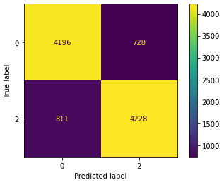
NLP: Sentiment Classifier - Building a model
Train/Test split: 80/20 (stratified splitting)
Transformed to TFIDVectors
Algorithm: Logistic Regression
Accuracy: 84.5% on unseen test case
Confusion Matrix:
Notes:
Add AUC

Slide 8
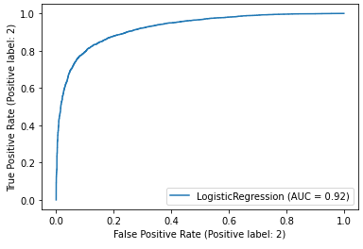
NLP: Sentiment Classifier - Model Performance
Confusion Matrix
ROC Curve

Slide 9
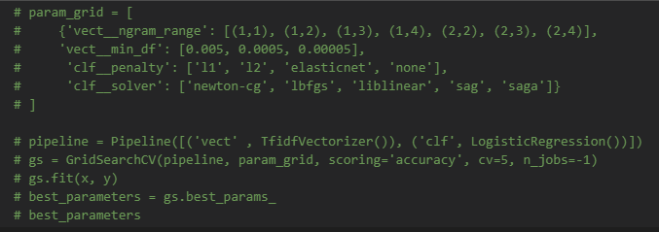
NLP: Sentiment Classifier - Improvement
One can apply GridSearch or RandomSearch for tuning the vectorizer and the model (finding the optimal n-gram level for classification)

Slide 10
NLP: Sentiment Classifier - Improvement
One can apply GridSearch or RandomSearch for tuning the vectorizer and the model (finding the optimal n-gram level for classification)

Slide 11
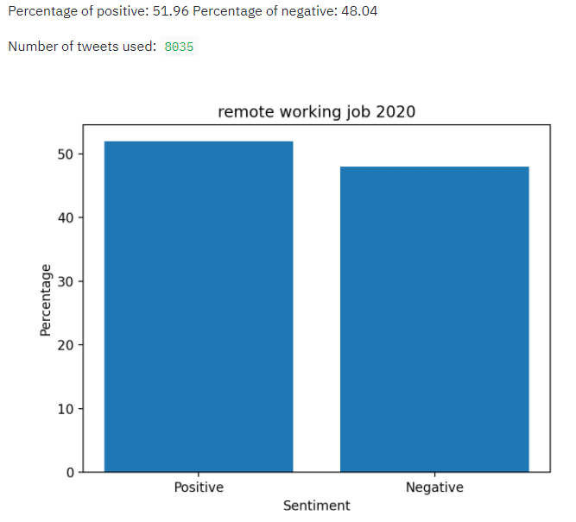
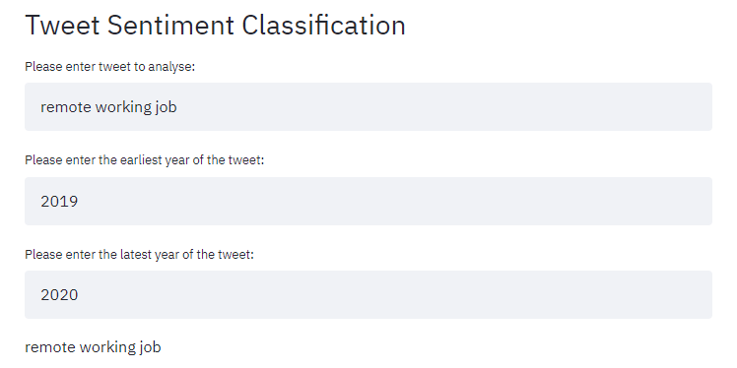
NLP: Sentiment Classifier - Post-processing (App)
Dynamic predictions based on user input + data visualisation

Slide 12
Results

Slide 13
Interviews and meetings held online
- The new norm
Do people like online meetings and interviews?

Slide 14
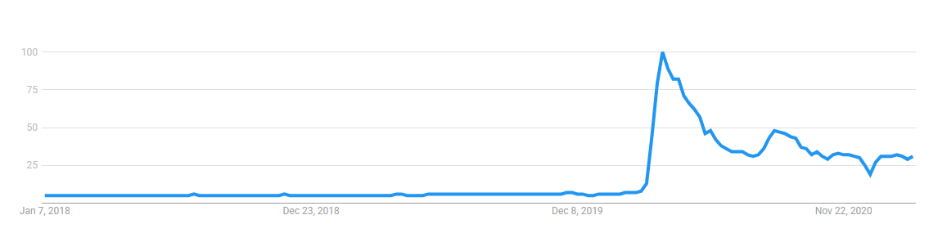
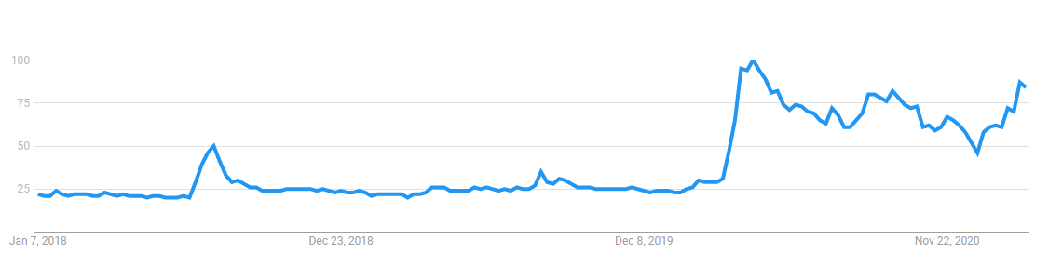
Zoom’s Increase in Relevancy - Google Trends
March 2020
Google Search
of the word “Zoom”
YouTube Search
of the word “Zoom”
Timeline 2018 - 2020
Timeline 2018 - 2020
March 2020

Slide 15
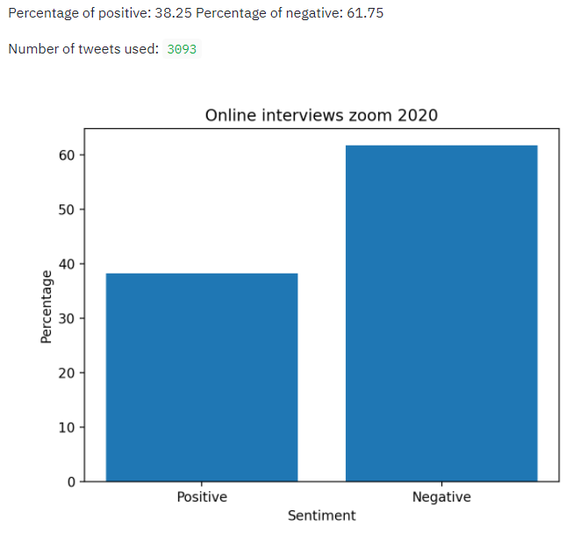
Tweets containing ‘online, interviews, zoom’
~38% Positive tweets, ~62% Negative tweets

Slide 16
Online Education - The New Norm
How did University Students view online education?

Slide 17
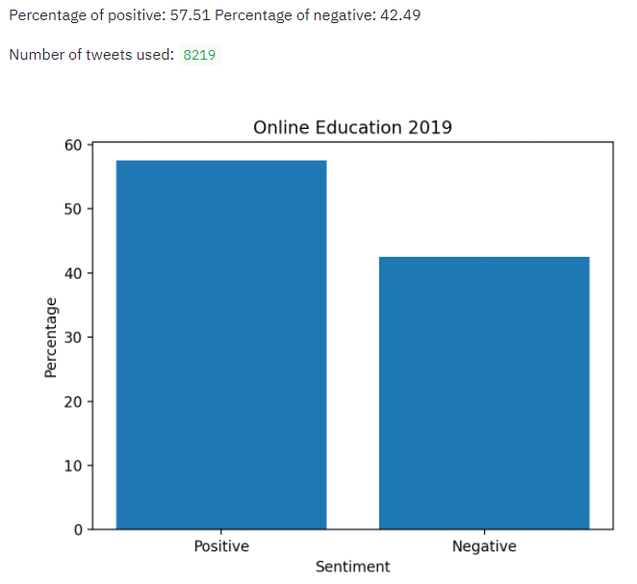
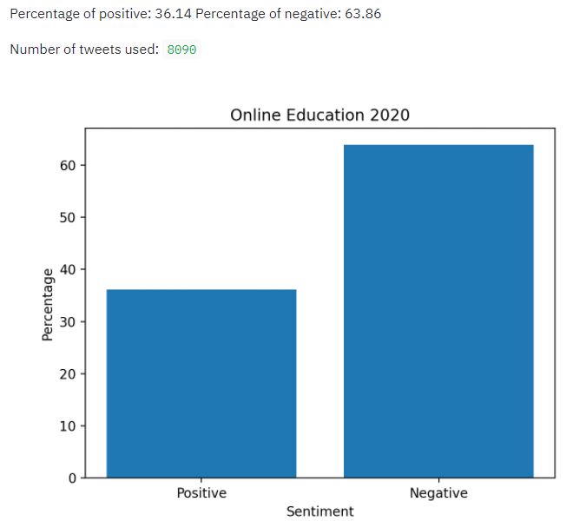
Tweet containing ‘online, education’
~20% decrease in positive tweets in 2020-2021
Notes:
Mention the number of tweets extracted
Add some statistics in the methodology

Slide 18
University Students outlook on Online Education
~20% decrease in positive tweets in 2020-2021
Interpretation: Prior to 2020, online education often referred to Coursera, edx, Udemy which are appreciated by many learners. In 2020, online university education became the norm, and sentiment towards ‘online education’ is no longer viewed in the positive light
Notes:
Mention the number of tweets extracted
Add some statistics in the methodology

Slide 19
Mental Health of University Students
Is there any change in sentiment regards to tweets about mental health?

Slide 20
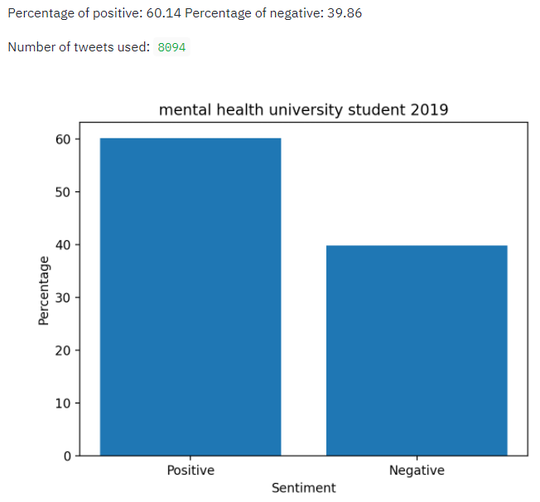
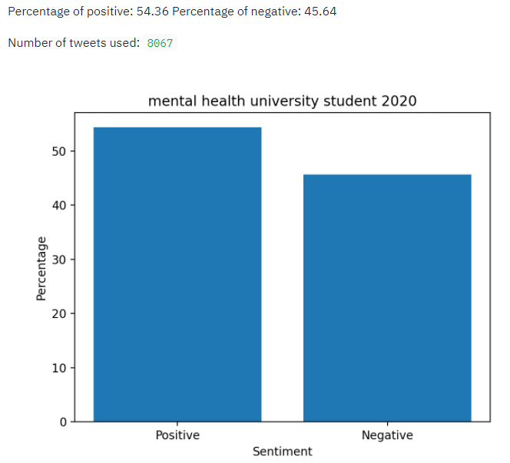
Tweets containing ‘mental, health, university, student’
~6% decrease in positive tweets in 2020
Notes:
Consider other keywords: e.g., depression

Slide 21
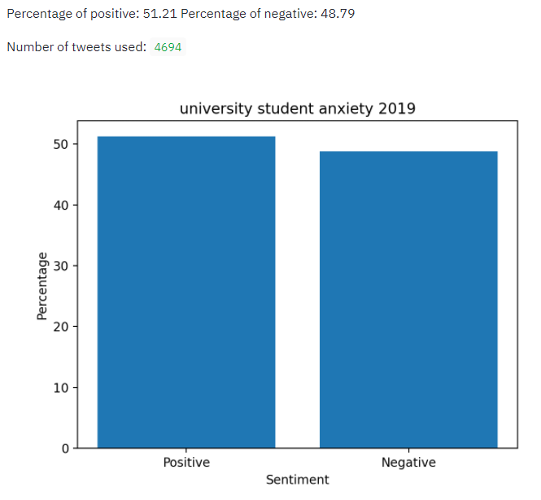
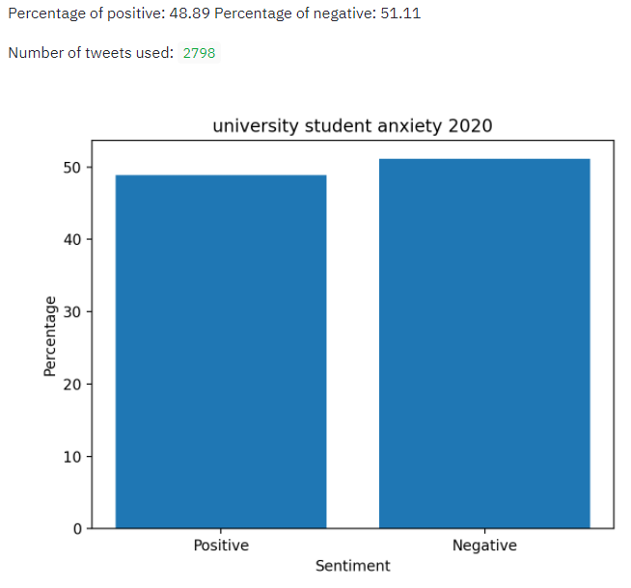
Tweets containing ‘university, student, anxiety’
~2% decrease in positive tweets in 2020
~50% decrease in number of tweets
Notes:
Consider other keywords: e.g., depression

Slide 22
Tweet containing ‘university, student, anxiety’
~2% decrease in positive tweets in 2020
~50% decrease in number of tweets
Interpretation: 2019 had higher percentage of positive tweets; the tweets could have been related to mental support and overcoming anxiety. However, with 50% decrease in number of tweets related to anxiety, perhaps people did feel more anxious and therefore no longer posted actively positive tweets regarding anxiety.
Notes:
Consider other keywords: e.g., depression

Slide 23
Interpretations of reduction in positive tweets regarding mental health by University Students
Lack of social networking
Limited in-class interaction (although engagement is increased in chat!)
Societies closed, parties are disallowed and University life is not what it used to be
~6% and ~2% decrease is not too significant - some may take it as an advantage, no commuting required and pre-recorded lectures allow them to study at their own pace
Notes:
Get sentiment for keywords like social networking as well

Slide 24
Remote Working - The New Norm
How did employees view remote working?

Slide 25
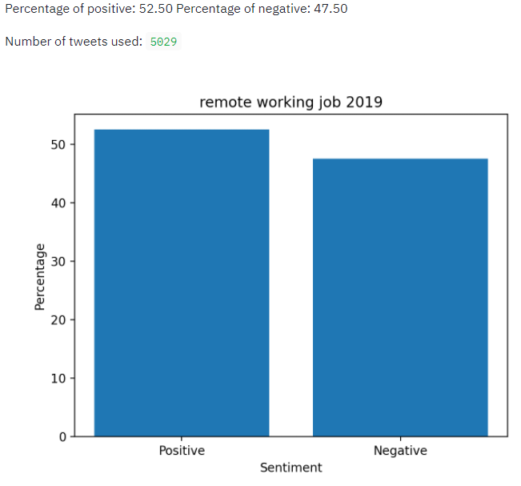
Tweets containing ‘remote, working, job’
~1% decrease in positive tweets in 2020
Insignificant change

Slide 26
Staying indoors - The New Norm
Can this be beneficial?

Slide 27
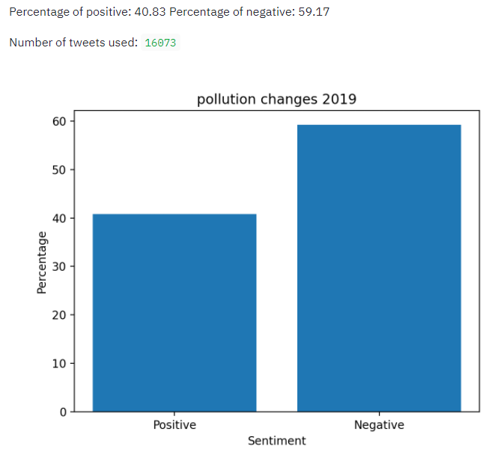
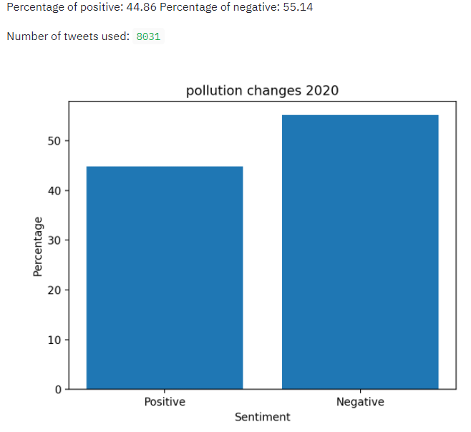
Tweets containing ‘pollution, changes’
~4% increase in positive tweets in 2020 due to reduction in pollution
Source: https://www.bbc.com/news/uk-scotland-53015092

Slide 28
Pollution Changes - did we reduce pollution intentionally?

Slide 29
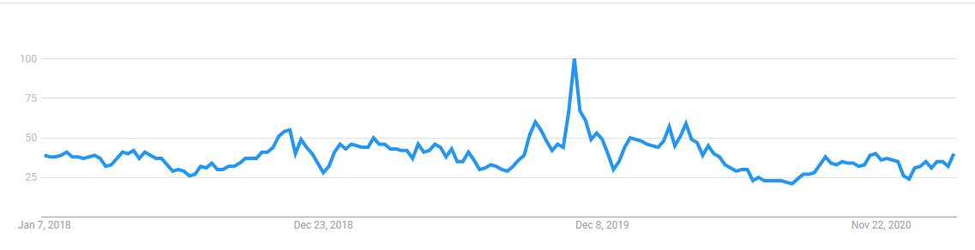
Pollution Web Searches
No increase in pollution searches on Google trends during the pandemic
Possible interpretation: no changes in the trend suggest no major policy or action was taken to reduce pollution; people did not intentionally increase their efforts to reduce pollution; rather, the reduction in pollution was a result of lockdowns
Alternative interpretation: one does not necessarily need to do web searches when he/she decides to contribute to pollution reduction, hence this may not be portrayed by Google trends

Slide 30
Further Improvement
Create a word cloud to display the most common words that occur in these tweets to obtain deeper insight into the motives behind sentiment changes
Limit number of tweets to be extracted is not consistent (e.g. number of tweets sometimes cross the limit) - potential error in the Twint library as it was noted by some developers (source: https://github.com/twintproject/twint/issues/237)

Slide 31
Conclusion
COVID has changed the way we live and introduced several new norms:
Zoom became one of our main tools
Online education became the norm
Working remotely became the norm
Staying indoors on regular basis became the norm
Stay home, stay safe!

Slide 32
Datathon Challenge Takeaway
Learnt how to use TWINT for Web Scraping tweets from Twitter
Learnt how to use Streamlit for deploying an app
Sharpened NLP skills
Gained rich insight into the life of a Data Scientist through discussion panels
All within 1 day!
Thank you so much for organising this event, it was a pleasure!

